Slide 1
Introduction to P5
Creating with Shapes

Slide 2
Vocabulary
Function
Parameter
Argument
Canvas
JavaScript
HTML/CSS
Syntax
Pixel

Slide 3
Think Write Pair Share with your partner
What do you think JavaScript can do to help your web pages be more expressive in combination with HTML/CSS? - first jot your answer down on paper or in a doc, and then discuss with your partner. Once you have come to a consensus, then answer on the pear deck here in the space provided.
Notes:
🍐 This is a Pear Deck Text Slide
🍐 To edit the type of question, go back to the "Ask Students a Question" in the Pear Deck sidebar.

Slide 4
Mini Lesson:
How can we break down a drawing into basic shapes in P5.js?
We will be looking at a graph that helps us pre-plan our sketches in P5 to learn the layout of the canvas/background. Unlike what you are used to in Scratch where the center coordinates for x and y are: 0, 0 are located in the upper left hand corner of the canvas on P5. We will practice on the handouts first to see how to identify points for lines and then plot a rectangle and an ellipse and finally will try in the P5 editor. Included in the lesson is also a helpful handout to show you how to draw basic shapes with their necessary parameters. We will do a code along for these shapes to help you transfer your shapes to the P5 program.

Slide 5
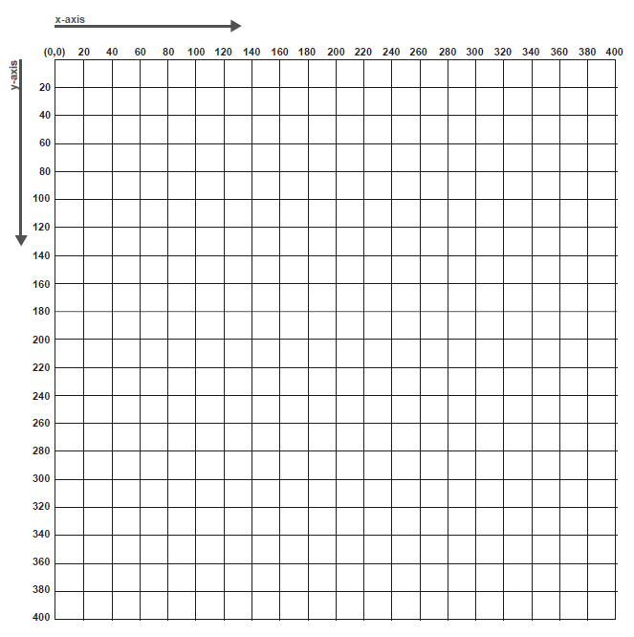

Slide 6
Quick Check:
What do you think the center points: x and y are in a canvas that measures 400 px by 400 px?
Notes:
🍐 This is a Pear Deck Text Slide
🍐 To edit the type of question, go back to the "Ask Students a Question" in the Pear Deck sidebar.

Slide 7
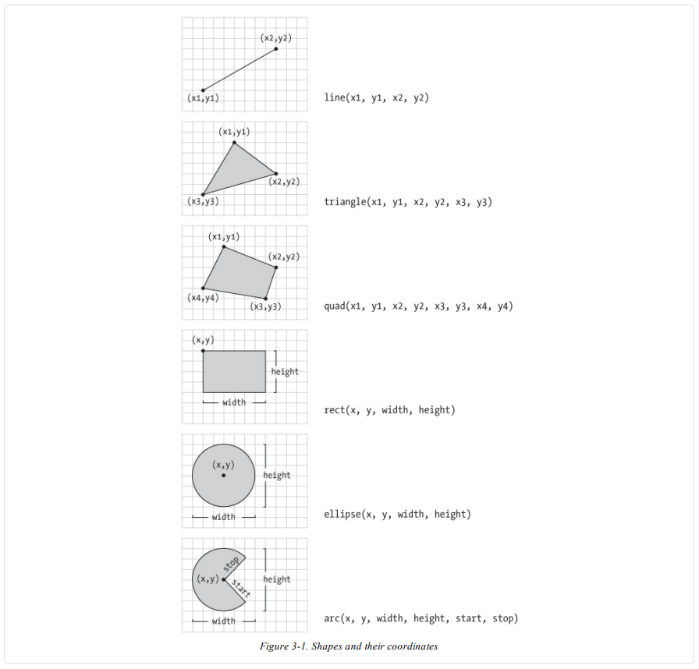

Slide 8
Deconstructing Lines
One the following slide you will be identifying the x and y points for the lines that are shown. We will do the example together and then you will work with your partner on the other 5 examples. When you complete it, you can put your responses on this pear deck or the following pear deck.
Notes:
🍐 This is a Pear Deck Text Slide
🍐 To edit the type of question, go back to the "Ask Students a Question" in the Pear Deck sidebar.

Slide 9
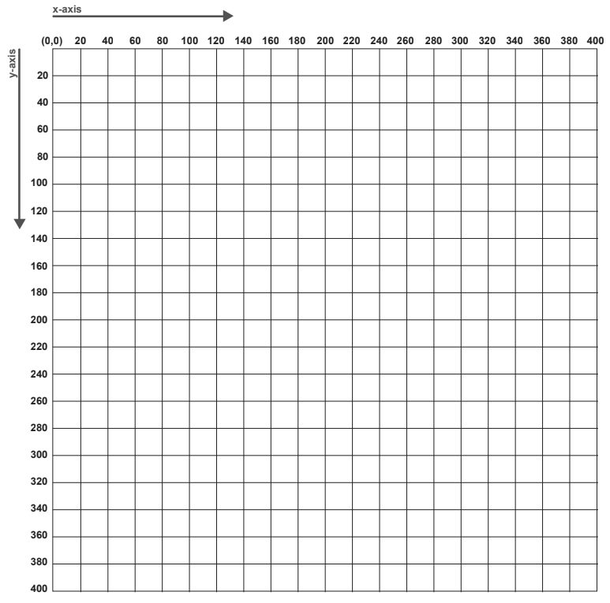
Example
1
2
3
5
4
Notes:
🍐 This is a Pear Deck Text Slide
🍐 To edit the type of question, go back to the "Ask Students a Question" in the Pear Deck sidebar.

Slide 10
Syntax for Rectangle
rect(x, y, w, h)
Parameters
X - Number: x-coordinate of the rectangle
Y - Number: y-coordinate of the rectangle
W - Number: Width of the rectangle
H - Number: height of the rectangle

Slide 11
Syntax for Ellipse
Ellipse (x, y, w, h)
Parameters
X - Number: x-coordinate of the ellipse
Y - Number: y-coordinate of the ellipse
W - Number: Width of the ellipse
H - Number: height of the ellipse

Slide 12
How the P5 program runs:
the setup() and draw() functions:
These functions are special because p5 calls them automatically when a sketch is run. They don’t have parameters, so the parentheses are empty.
We use the setup() function to set up a sketch. In order to draw anything in p5, we need to make a canvas and give it a size (like 400 x 400) by calling createCanvas() inside setup(). When you hit play, anything that is inside the setup() function will run one time.
In this unit, all of our shape functions will be called inside draw().
The code inside the draw() function actually runs in a loop. Every function we use inside draw is being called over and over again until the program is stopped. The loop happens so fast that the preview looks like one image, but in reality, the shapes are constantly being drawn on top of each other. Note: This loop will become relevant when students add color to their shapes, and later when they learn to animate shapes.

Slide 13
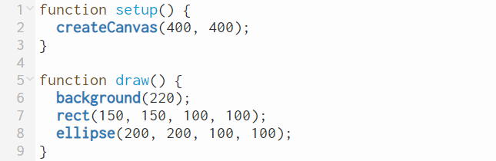
ellipse is on top of the rectangle, and it’s because the program draws the rectangle first then ellipse. Everything in the draw() loop (and the p5 sketch as a whole) will run from top to bottom.
For additional help visit YouTube on the Coding Train:
https://www.youtube.com/watch?v=yPWkPOfnGsw

Slide 14
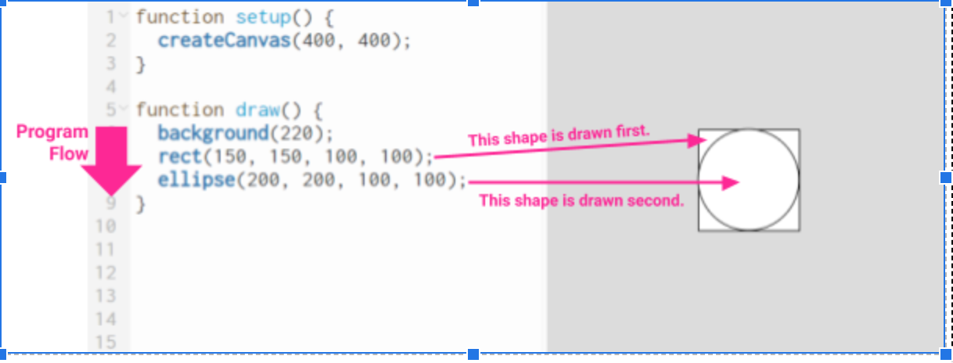

Slide 15
Closing: Answer the following questions
What did you learn in this lesson?
What did you find easy about this lesson?
What do you think you need more help with?
Notes:
🍐 This is a Pear Deck Text Slide
🍐 To edit the type of question, go back to the "Ask Students a Question" in the Pear Deck sidebar.

